Slide 1





History-Conditioned SAC under Sensor Faults:
A Pilot Study of Adaptation and Retention
Felix Surjodinoto*, Keandre Rafael, Delroy, Samuel Philip
Computer Science Department, School of Computer Science
Bina Nusantara University, Jakarta, Indonesia
ICoDiT 2026 | Paper ID: 193 | Springer Nature CCIS
November 19, 2026
Hybrid
(On-site & Virtual)
BINUS University @Alam Sutera,
Tangerang, Indonesia

Slide 2

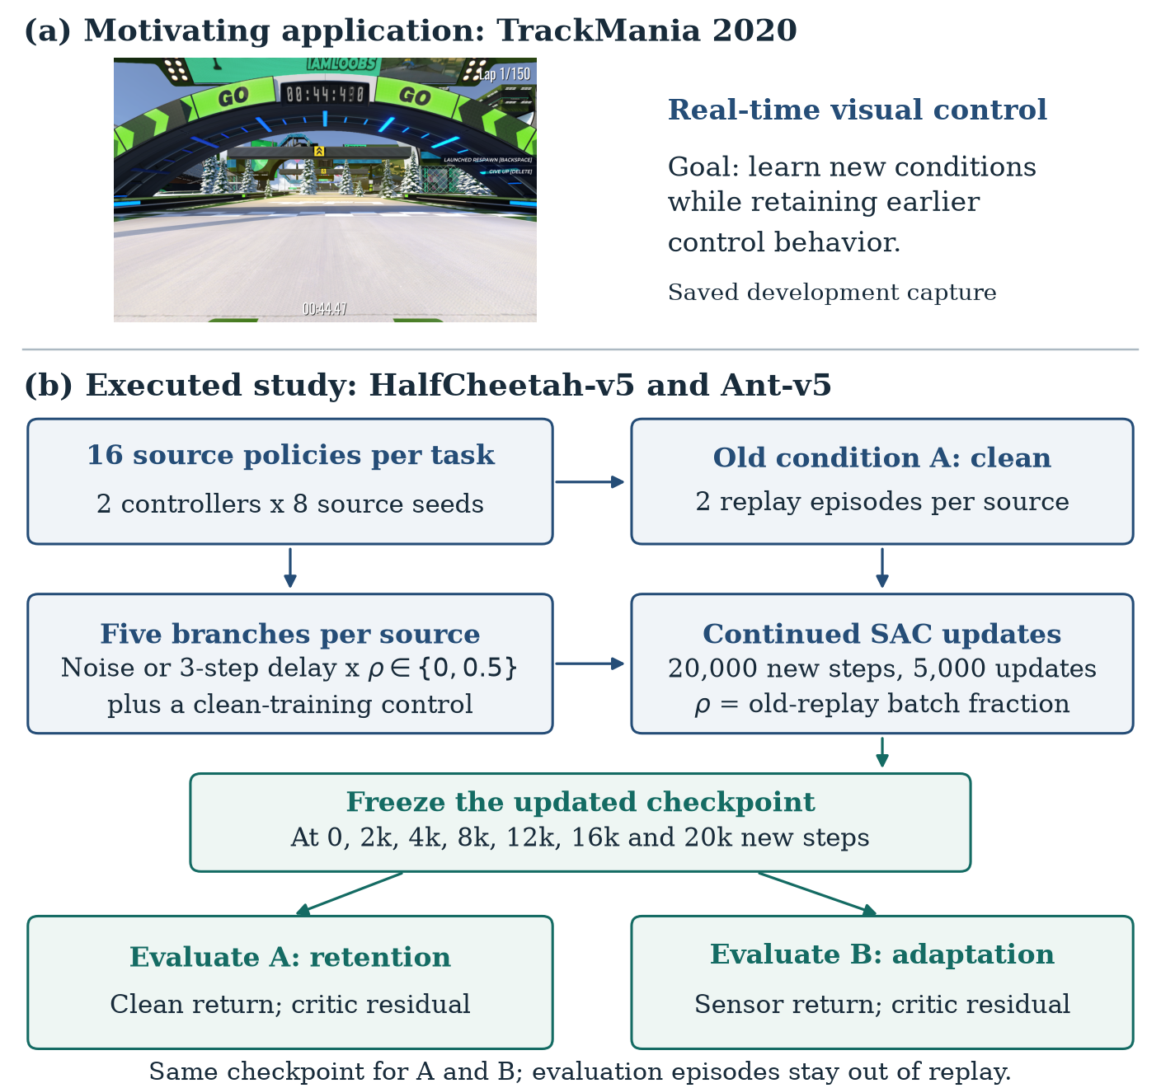
Why This Research? The Origin & Motivation
Training Plateaus in Real-Time TrackMania 2020 and the Mystery of Sensory Shifts
• The High-Speed Challenge: Our overarching goal is real-time visual control in TrackMania 2020 at 100–500 Hz. In this domain, sequence models and world models repeatedly encountered severe performance plateaus.
• The Diagnostic Dilemma: Why did policies stall? Did they suffer from loss of plasticity (inability to learn further)? Primacy bias (overfitting early data)? Or catastrophic forgetting during fine-tuning?
• The Physical Reality of Sensors: Physical deployment introduces unannounced sensory degradation: camera vibration (noise) and transmission lag (delay). Actuator faults change control; sensor faults change information.
• Need for Controlled Isolation: In end-to-end visual driving, these factors are deeply entangled. We needed a rigorous, controlled MuJoCo benchmark to isolate and measure adaptation and retention directly.

Slide 3
Core Research Questions (What We Set Out to Answer)
Decoupling Adaptation, Catastrophic Forgetting, and Replay Buffer Dynamics
• RQ1: Adaptation vs. Retention Trade-off: When a trained policy encounters unannounced sensory degradation, can continued training restore return (Adaptation), and does fine-tuning erase performance on nominal clean conditions (Retention)?
• RQ2: Architectural Inductive Bias: Does history conditioning via a sequence model (Causal Transformer) provide an architectural buffer against sensor faults compared to a memoryless reactive MLP, or does past context misinform under latency?
• RQ3: The Replay Buffer Dilemma: Does the standard continual learning remedy—mixing prior clean experience into replay—prevent forgetting, or does it introduce an off-policy distribution mismatch that corrupts Bellman value targets?
• RQ4: Real-Time Edge Feasibility: Can an expressive history-conditioned transformer execute within the strict sub-2ms cycle budget required for 500 Hz physical robotic control on edge CPU hardware?

Slide 4
Experimental Formulation & Fault Modeling
Partially Observable Formulation (POMDP) and Controlled 5-Branch Protocol
• POMDP Formulation: Continuous control modeled as M = (S, A, T, R, Omega, O, gamma), where the policy receives degraded observations s_tilde_t rather than ground-truth physical states.
• Fault Model 1: Gaussian Noise: s_tilde_t = s_t + e_t, e_t ~ N(0, sigma^2 I) with sigma = 0.15. Perturbs signal amplitude without introducing temporal lag.
• Fault Model 2: Observation Delay: FIFO ring buffer of depth d = 3 (s_tilde_t = s_t-d). Breaks Markovian velocity tracking; observation represents outdated physical plant state.
• 5-Branch Experimental Design: 1. Clean Control (isolates optimization drift)
2. Noise Only (pure adaptation)
3. Noise + Replay (rehearsal)
4. Delay Only (pure adaptation)
5. Delay + Replay (rehearsal)
• Paired-Seed Statistical Rigour: 8 independent source seeds per controller and task (160 policy branches, 20,000 steps each). Exact Wilcoxon signed-rank tests with Holm-Bonferroni correction.

Slide 5
Architectural Inductive Biases: Memory vs. Reactivity
History-Conditioned Causal Transformer vs. Reactive MLP Baseline
• Reactive Controller Baseline (MLP): Standard SAC policy: 2 hidden layers with 256 units each, ReLU activations. 71.9k actor / 72.5k critic parameters. Memoryless mapping s_t -> a_t, strictly reliant on instantaneous input.
• History-Conditioned Controller (Transformer): GPT-style causal transformer: sliding context window K = 10 steps, token embedding d_model = 64, 2 causal self-attention blocks (4 heads), LayerNorm, and MLP projection head (87.6k actor / 92.3k critic parameters).
• In-Context Boundary Handling: Context resets at episode boundaries. The model observes historical trajectory segments; cross-episode adaptation occurs exclusively through continued parameter updates.
• Replay Mixing Rehearsal: 50% nominal clean transitions mixed with 50% online corrupted transitions to investigate whether memory preservation impairs adaptation velocity.

Slide 6
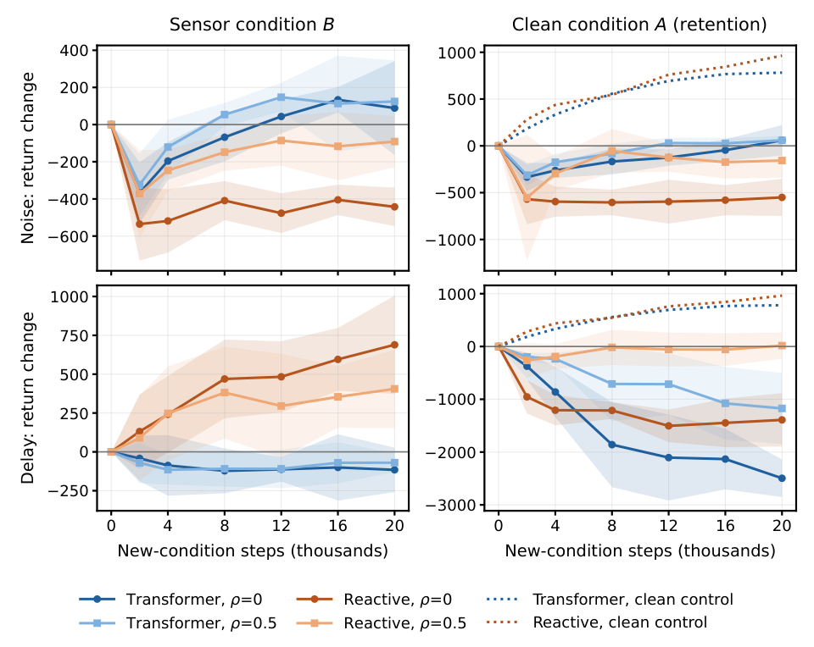
Empirical Findings: HalfCheetah-v5 Dynamics
High-Frequency Noise Filtering vs. Catastrophic Observation Delay Collapse
• Observation 1: Noise Resilience: Under Gaussian sensor noise, both reactive MLP and transformer adapt swiftly, recovering near-optimal velocity. Replay mixing successfully prevents catastrophic forgetting with minimal penalty.
• Observation 2: The Severe Delay Crash: Observation delay causes immediate, severe performance collapse (>2,000 return penalty). Continued training achieves only partial recovery across 20,000 steps.
• The Transformer Delay Paradox: Under delay, the transformer actually struggled more than the reactive MLP! Causal self-attention attended to stale past tokens that misrepresented current plant physics, amplifying control latency.

Slide 7
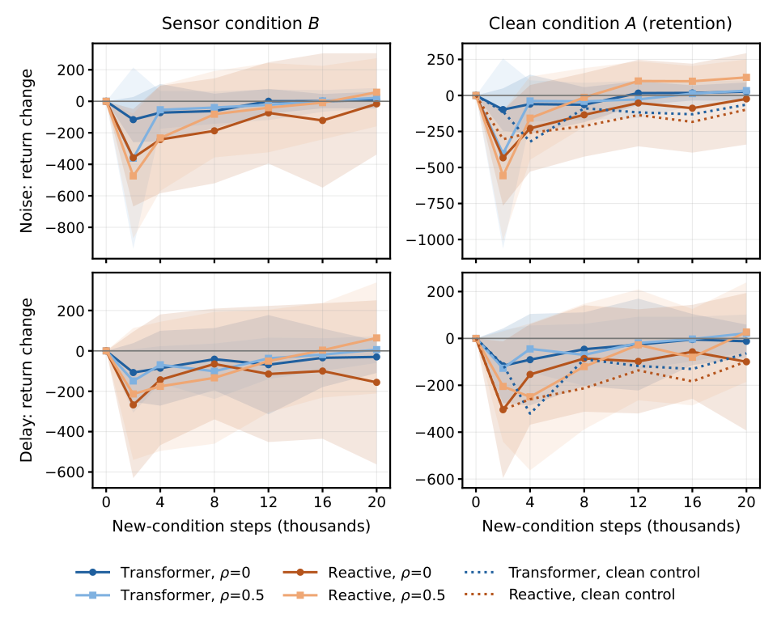
Empirical Findings: Ant-v5 & Morphological Sensitivity
Morphological Standing Posture and the Warm-Start Re-Optimization Dip
• Observation 3: Morphological Immunity: Under the standardized 400,000-step source recipe, all 8 Ant source seeds converged to an ultra-stable standing posture (mean forward velocity +/-0.007 m/s).
• Negligible Fault Sensitivity: Because standing requires minimal dynamic velocity feedback, sensor noise and delay caused virtually zero return penalty. Reported transparently rather than retroactively tuning hyperparameters.
• Observation 4: Re-Optimization Transient: All Ant branches (including clean controls) dipped in return during the first 2,000 steps before recovering. Scientific Insight: This transient dip is caused by re-starting the Adam optimizer, NOT by sensor faults!

Slide 8
Mechanistic Critic Diagnostic: Soft Bellman Target Distortion
Explaining Why Replay Buffer Mixing Hurt Adaptation Under Observation Delay
• Diagnostic Framework: Both soft Q-critics evaluated on held-out clean and corrupted trajectories at source checkpoint and after 20,000 steps. Evaluated soft Bellman residual and Monte-Carlo value-bias gap (Bias_corrupt - Bias_clean).
• Massive Source Value Overestimation: Source critics severely overvalued delayed history states (+171 and +268 return units in HalfCheetah).
• Distortion From Replay Mixing: Training on corrupted data alone shrank the bias gap to +27 and +114. Mixing 50% clean replay maintained the gap elevated at +89 and +204 (paired effect: +62 [16, 109] and +90 [41, 139], 7/8 seeds positive).
• Theoretical Explanation: Mixing stale clean transitions creates an off-policy distribution mismatch that actively distorts the soft Bellman target, proving that naive rehearsal harms adaptation under non-Markovian delay.

Slide 9
Real-Time Edge Viability: 500 Hz Benchmark
Sub-Millisecond Inference Proves Feasibility for High-Speed Robotic Control
Platform | Controller | Threads | Mean Latency | 99th %ile | Max Latency | 500 Hz Viable?
CPU (i7-8700) | Transformer Actor | 1 thread | 0.58 ms | 0.66 ms | 1.56 ms | YES (Budget < 2.0 ms)
CPU (i7-8700) | Reactive MLP Actor | 1 thread | 0.09 ms | 0.12 ms | 0.28 ms | YES
CPU (i7-8700) | Transformer Actor | 4 threads | 0.64 ms | 0.78 ms | 1.82 ms | YES
GPU (RTX 3070 Ti) | Transformer Actor | CUDA | 1.64 ms | 1.92 ms | 3.14 ms | MARGINAL (Kernel overhead)
• 10,000 Timed Forward Passes: Measured at deployment batch size 1 with real model inputs (excluding physics engine simulation overhead).
• Strict Real-Time Compliance: Transformer inference on single-threaded CPU consistently completes in under 1.56 ms, comfortably within the 2.0 ms cycle budget of 500 Hz robotics.
• Edge Architecture Takeaway: Single-threaded CPU execution outperforms GPU at batch size 1, confirming suitability for embedded robot microcontrollers without dedicated discrete accelerators.

Slide 10
Answers to the Research Questions: Key Takeaways
Actionable Scientific Insights for Fault-Tolerant Reinforcement Learning
• Answer to RQ1 (Adaptation vs Retention): Adaptation is fast and complete under high-frequency noise with full retention, but severely degraded under delay where nominal competence is permanently impaired.
• Answer to RQ2 (Transformer Inductive Bias): History conditioning acts as a natural temporal low-pass filter under noise, but exacerbates vulnerability under delay unless delay is explicitly compensated in the state representation.
• Answer to RQ3 (Replay Buffer Trade-off): Replay buffer mixing is not a universal panacea: it preserves nominal skills under noise, but induces severe soft Bellman target distortion under non-Markovian delay.
• Answer to RQ4 (High-Rate Control Viability): History-conditioned transformers require only 87k parameters and execute in 0.58 ms on a single CPU thread, satisfying real-time 500 Hz robotics.

Slide 11
The Path Forward & Open Science
Returning to TrackMania 2020, Physical Robotics, and Open Artifact Release
• Implications for TrackMania & Robotics: To overcome real-world delay, future controllers must incorporate explicit delay-aware predictive heads, temporal attention discounting, and dynamic uncertainty-weighted replay sampling.
• Scalability Outlook: Next phase investigates scaling these insights to high-dimensional continuous control (Humanoid-v5) and vision-based end-to-end TrackMania pipelines.
• Full Open Science Release: Complete reproducible codebase, sensor fault wrappers, frozen seed protocols, evaluation records, and checkpoints available at: https://github.com/Fane-Nathan/tmrl
• Primary Contact: Felix Surjodinoto (felix.surjodinoto@binus.ac.id) | Bina Nusantara University

